Slide 1
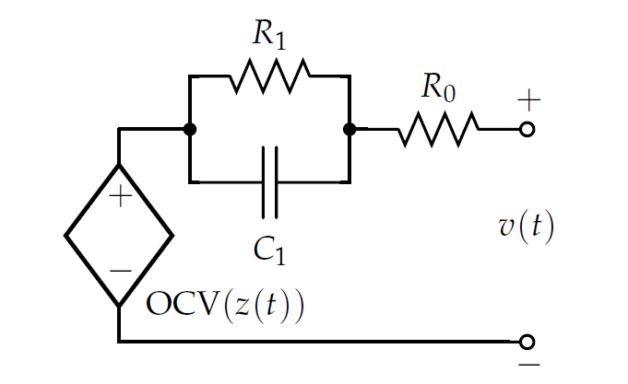
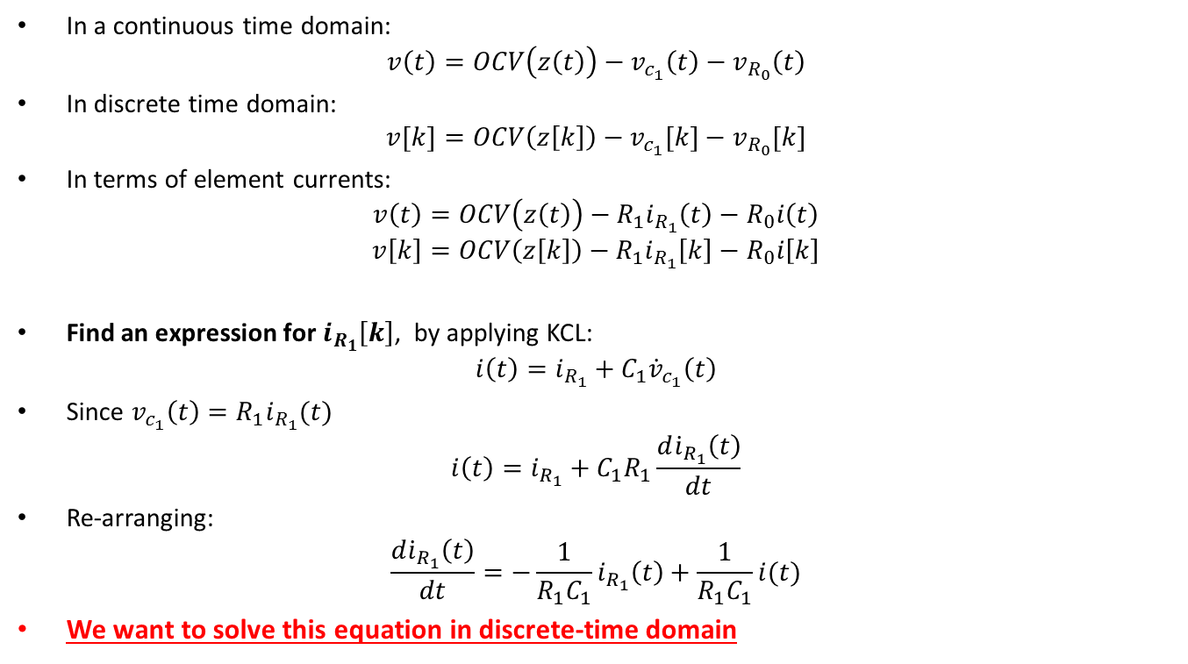



EQUIVALENT CIRCUIT BATTERY MODEL: DERIVATION
In a continuous time domain:
$$v\left(t\right)=OCV\left(z\left(t\right)\right)−v_{c_{1}}\left(t\right)−v_{R_{0}}\left(t\right)$$
In discrete time domain:
$$v[k]=OCV\left(z\left[k\right]\right)−v_{c_{1}}[k]−v_{R_{0}}[k]$$
In terms of element currents:
$$v\left(t\right)=OCV\left(z\left(t\right)\right)−{R_{1}i}_{R_{1}}\left(t\right)−R_{0}i\left(t\right)$$
$$v\left[k\right]=OCV\left(z\left[k\right]\right)−{R_{1}i}_{R_{1}}\left[k\right]−R_{0}i\left[k\right]$$
Find an expression for $i_{R_{1}}\left[k\right]$, by applying KCL:
$$i\left(t\right)=i_{R_{1}}+C_{1}{\dot{v}}_{c_{1}}\left(t\right)$$
Since $v_{c_{1}}\left(t\right)=R_{1}i_{R_{1}}(t)$
$$i\left(t\right)=i_{R_{1}}+C_{1}R_{1}\frac{d{\dot{i}}_{R_{1}}\left(t\right)}{dt}$$
Re-arranging:
$$\frac{d{\dot{i}}_{R_{1}}\left(t\right)}{dt}=−\frac{1}{R_{1}C_{1}}i_{R_{1}}\left(t\right)+\frac{1}{R_{1}C_{1}}i(t)$$
We want to solve this equation in discrete-time domain
$$i_{R_{1}}(t)$$
$$i(t)$$
$$i_{c_{1}}(t)$$
BATTERY MANAGEMENT SYSTEMS, VOLUME I, BATTERY MODELING, G. Plett

Slide 2

EQUIVALENT CIRCUIT BATTERY MODEL: BATTERY MODEL - CONTINIOUS FORM
Output Equation
$\frac{d{\dot{i}}_{R_{1}}\left(t\right)}{dt}=−\frac{1}{R_{1}C_{1}}i_{R_{1}}\left(t\right)+\frac{1}{R_{1}C_{1}}i\left(t\right)$
$v\left(t\right)=OCV\left(z\left(t\right)\right)−R_{1}i_{R_{1}}\left(t\right)−R_{0}i(t)$
Coulomb Counting (System Equation)
$\dot{z}\left(t\right)=−η\left(t\right)i(t)/Q$

Slide 3
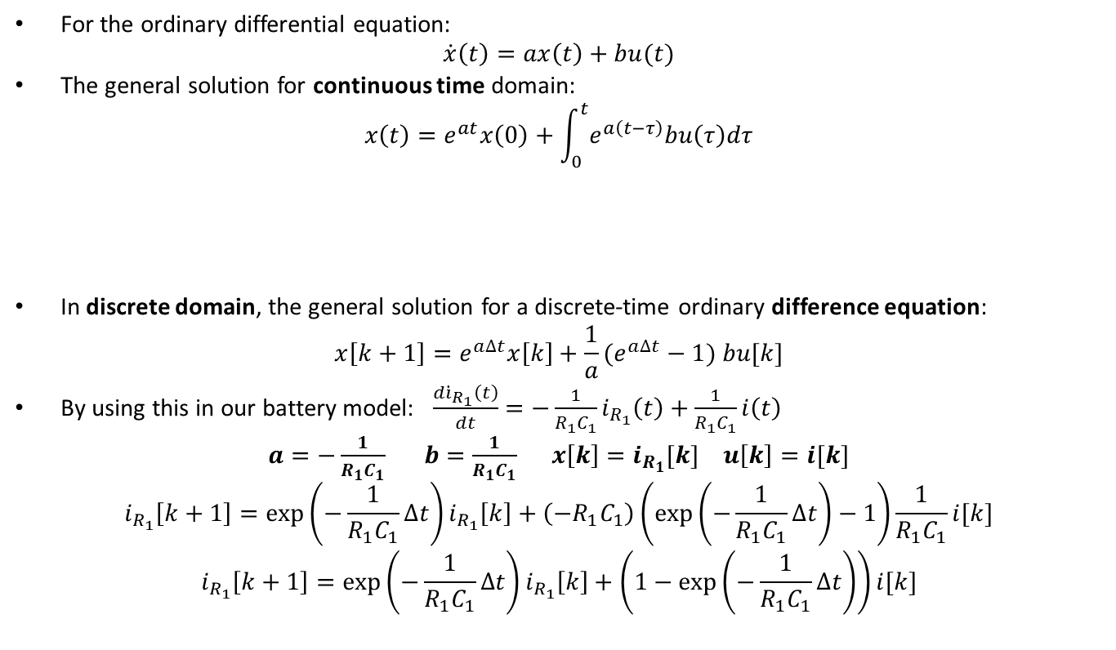
EQUIVALENT CIRCUIT BATTERY MODEL: ODE SOLUTION DERIVATION
For the ordinary differential equation:
$$\dot{x}\left(t\right)=ax\left(t\right)+bu(t)$$
The general solution for continuous time domain:
$$x\left(t\right)=e^{at}x\left(0\right)+\int_{0}^{t}{e^{a\left(t−τ\right)}bu\left(τ\right)dτ}$$
In discrete domain, the general solution for a discrete-time ordinary difference equation:
$$x\left[k+1\right]=e^{a∆t}x\left[k\right]+{\frac{1}{a}(e}^{a∆t}−1) bu[k]$$
By using this in our battery model: $\frac{d{\dot{i}}_{R_{1}}\left(t\right)}{dt}=−\frac{1}{R_{1}C_{1}}i_{R_{1}}\left(t\right)+\frac{1}{R_{1}C_{1}}i\left(t\right)$
$a=−\frac{1}{R_{1}C_{1}}$ $b=\frac{1}{R_{1}C_{1}}$ $x\left[k\right]=i_{R_{1}}[k]$ $u\left[k\right]=i[k]$
$$i_{R_{1}}\left[k+1\right]=\exp\left(−\frac{1}{R_{1}C_{1}}∆t\right)i_{R_{1}}\left[k\right]+\left(−R_{1}C_{1}\right)\left(\exp\left(−\frac{1}{R_{1}C_{1}}∆t\right)−1\right)\frac{1}{R_{1}C_{1}}i[k]$$
$$i_{R_{1}}\left[k+1\right]=\exp\left(−\frac{1}{R_{1}C_{1}}∆t\right)i_{R_{1}}\left[k\right]+\left(1−\exp\left(−\frac{1}{R_{1}C_{1}}∆t\right)\right)i[k]$$
Depends on Initial condition
Depends on input signal
convolution integral
BATTERY MANAGEMENT SYSTEMS, VOLUME I, BATTERY MODELING, G. Plett

Slide 4
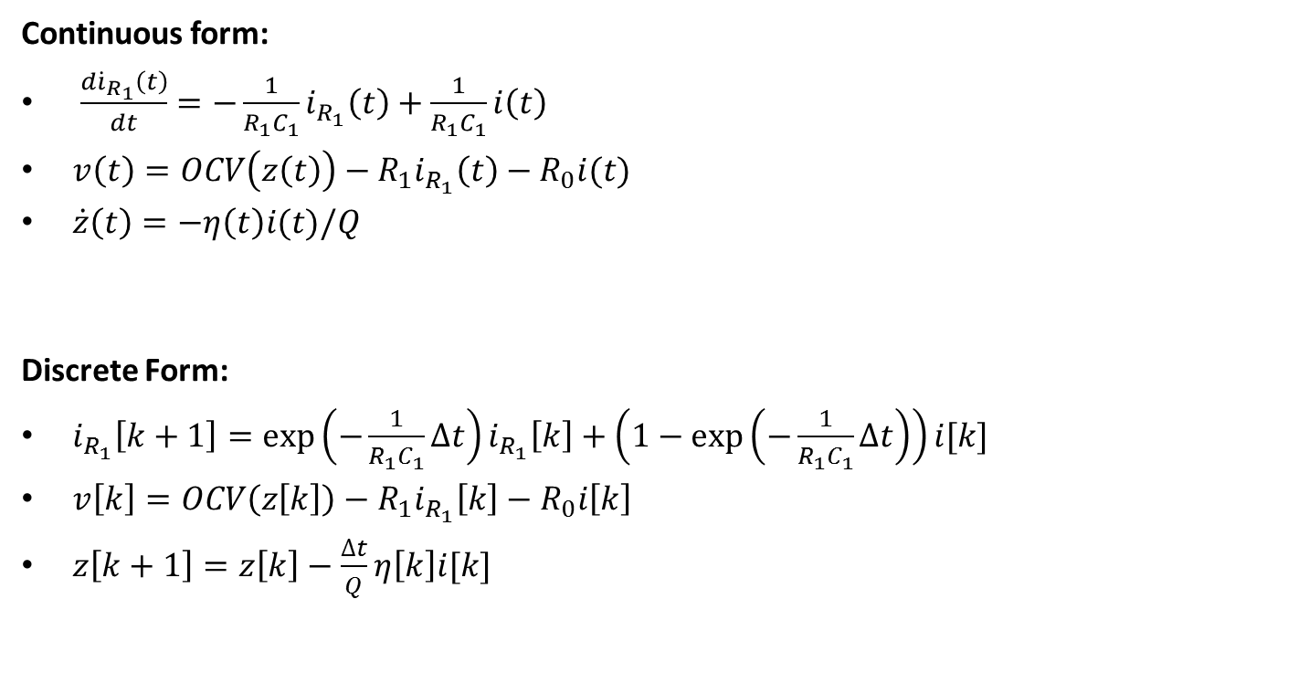
EQUIVALENT CIRCUIT BATTERY MODEL: OVERALL BATTERY MODEL
Continuous form:
$\frac{d{\dot{i}}_{R_{1}}\left(t\right)}{dt}=−\frac{1}{R_{1}C_{1}}i_{R_{1}}\left(t\right)+\frac{1}{R_{1}C_{1}}i\left(t\right)$
$v\left(t\right)=OCV\left(z\left(t\right)\right)−R_{1}i_{R_{1}}\left(t\right)−R_{0}i(t)$
$\dot{z}\left(t\right)=−η\left(t\right)i(t)/Q$
Discrete Form:
$i_{R_{1}}\left[k+1\right]=\exp\left(−\frac{1}{R_{1}C_{1}}∆t\right)i_{R_{1}}\left[k\right]+\left(1−\exp\left(−\frac{1}{R_{1}C_{1}}∆t\right)\right)i[k]$
$v\left[k\right]=OCV\left(z\left[k\right]\right)−{R_{1}i}_{R_{1}}\left[k\right]−R_{0}i\left[k\right]$
$z\left[k+1\right]=z\left[k\right]−$ $\frac{∆t}{Q}η\left[k\right]i[k]$

Slide 5
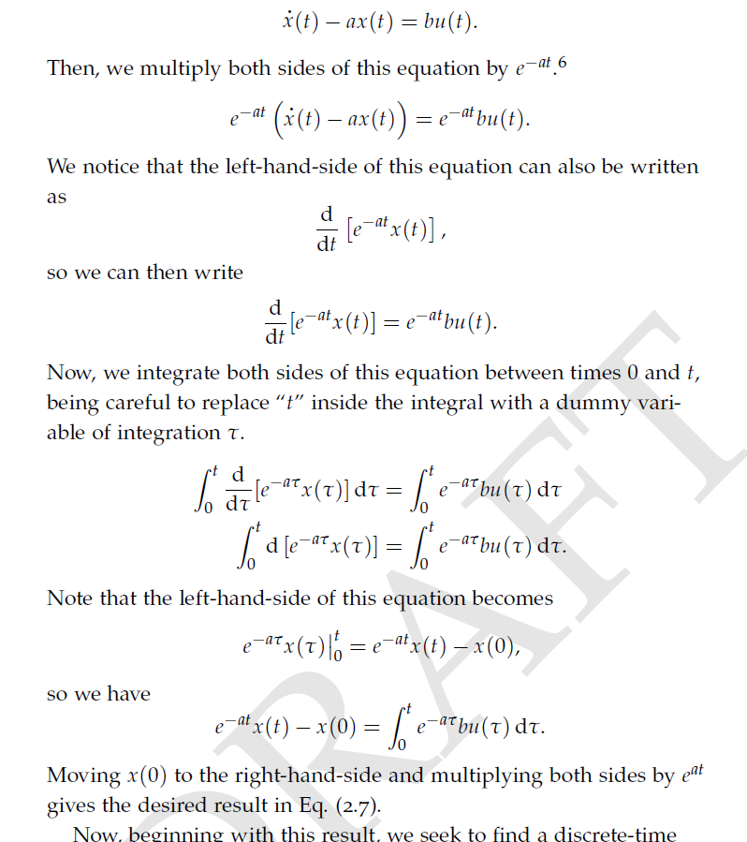
EQUIVALENT CIRCUIT BATTERY MODEL: ODE SOLUTION DERIVATION-CONTINIOUS
ODE Solution in continuous time
BATTERY MANAGEMENT SYSTEMS, VOLUME I, BATTERY MODELING, G. Plett

Slide 6
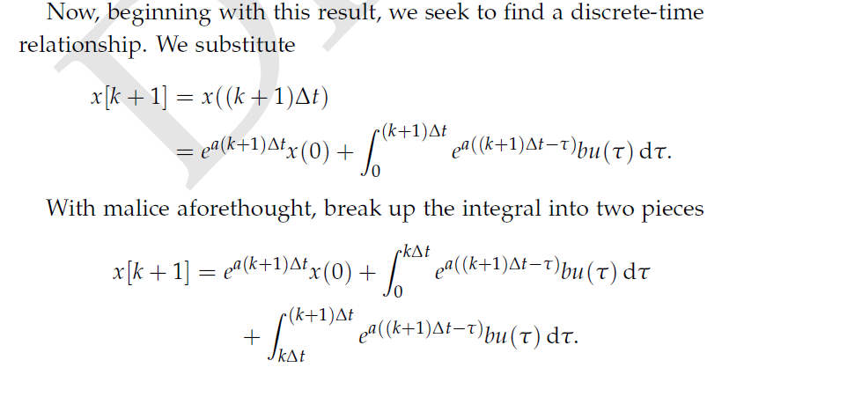
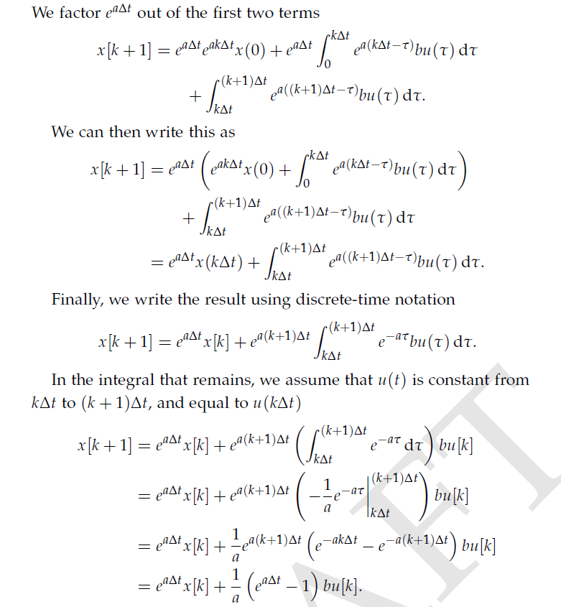
EQUIVALENT CIRCUIT BATTERY MODEL: ODE SOLUTION DERIVATION-DISCRETE
ODE Solution in discrete time
BATTERY MANAGEMENT SYSTEMS, VOLUME I, BATTERY MODELING, G. Plett

